Slide 1
THE TRIP BEGINS
Here is where your presentation begins

Slide 2
CONTENTS OF THIS TEMPLATE
Here’s what you’ll find in this Slidesgo template:
A slide structure based on a multi-purpose presentation, which you can easily adapt to your needs. For more info on how to edit the template, please visit Slidesgo School or read our FAQs.
An assortment of pictures that are suitable for use in the presentation can be found in the alternative resources slide.
A thanks slide, which you must keep so that proper credits for our design are given.
A resources slide, where you’ll find links to all the elements used in the template.
Instructions for use.
Final slides with:
The fonts and colors used in the template.
A selection of illustrations. You can also customize and animate them as you wish with the online editor.
Visit Stories by Freepik to find more.
More infographic resources, whose size and color can be edited.
Sets of customizable icons of the following themes: general, business, avatar, creative process, education, help & support, medical, nature, performing arts, SEO & marketing, and teamwork.
You can delete this slide when you’re done editing the presentation.

Slide 3
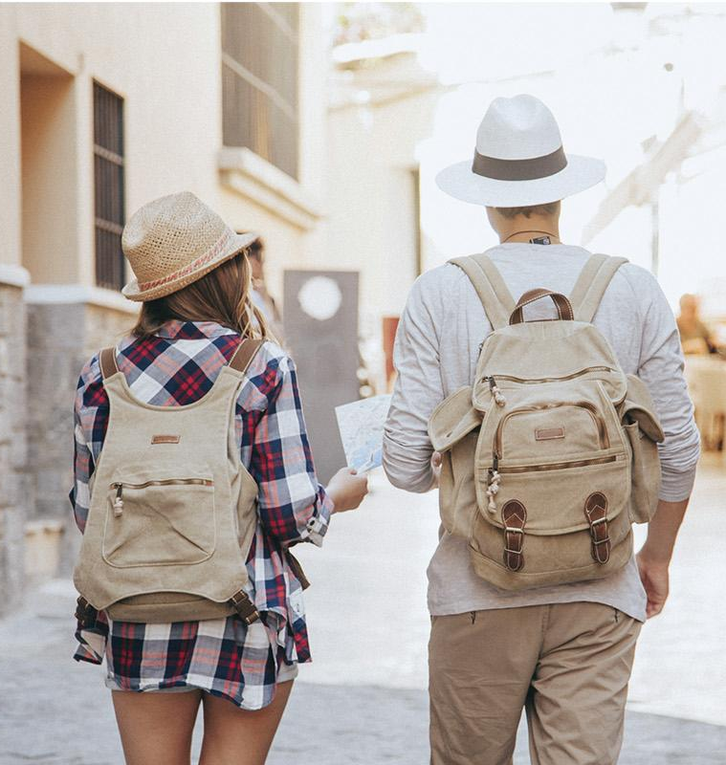
WHOA!
This could be the part of the presentation where you can introduce yourself, write your email…

Slide 4
ABOUT US
Here you can talk a bit about the topic. For example, you can say that Mercury is the smallest planet in the Solar System

Slide 5
01 COMPANY
03 DATES
Here you could describe the topic of the section
Here you could describe the topic of the section
02 PRESENTATION
04 ANALYSIS
Here you could describe the topic of the section
Here you could describe the topic of the section

Slide 6
—Someone Famous
“This is a quote, words full of wisdom that someone important said and can make the reader get inspired.”

Slide 7
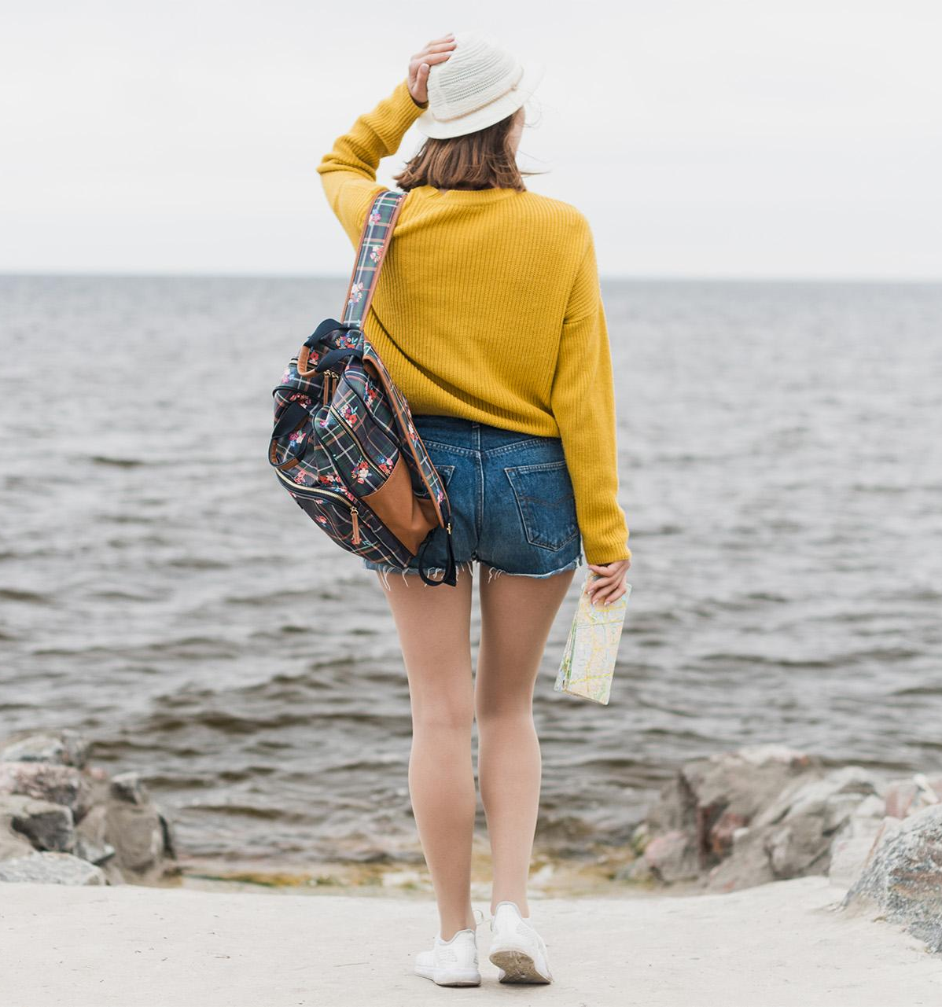
OUR STORY
Mercury is the closest planet to the Sun and the smallest one in the Solar System—it’s a bit larger than the Moon

Slide 8
01 COMPANY
You can enter a subtitle here if you need it

Slide 9
SERVICES
Mars
Jupiter
Mars is actually a cold place
It’s a gas giant and the biggest planet
Mercury
Venus
Mercury is the smallest planet
Venus has a beautiful name

Slide 10
AWESOME WORDS

Slide 11
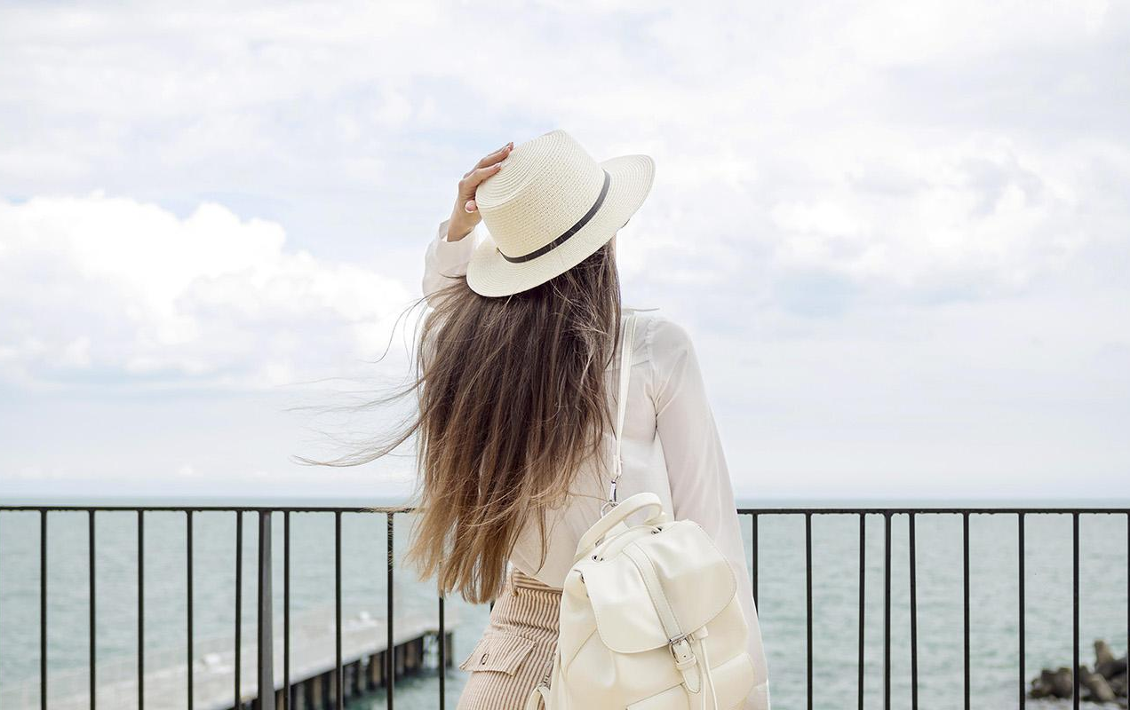
MAYBE YOU NEED
TO DIVIDE THE
CONTENT
Mercury
Venus
Mercury is the closest planet to the Sun and the smallest one in the Solar System
Venus has a beautiful name and is the second planet from the Sun. It’s terribly hot

Slide 12
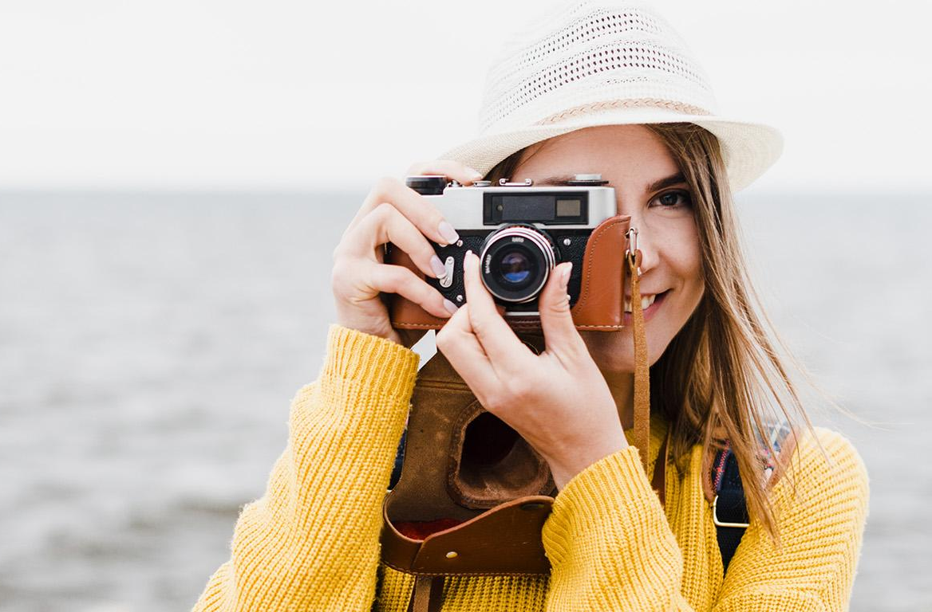
YOU COULD USE THREE COLUMNS, WHY NOT?
Mars
Jupiter
Venus
Mars is actually a cold place. It’s full of iron oxide dust
It’s a gas giant and the biggest planet in the Solar System
Venus has a beautiful name and is the second planet

Slide 13
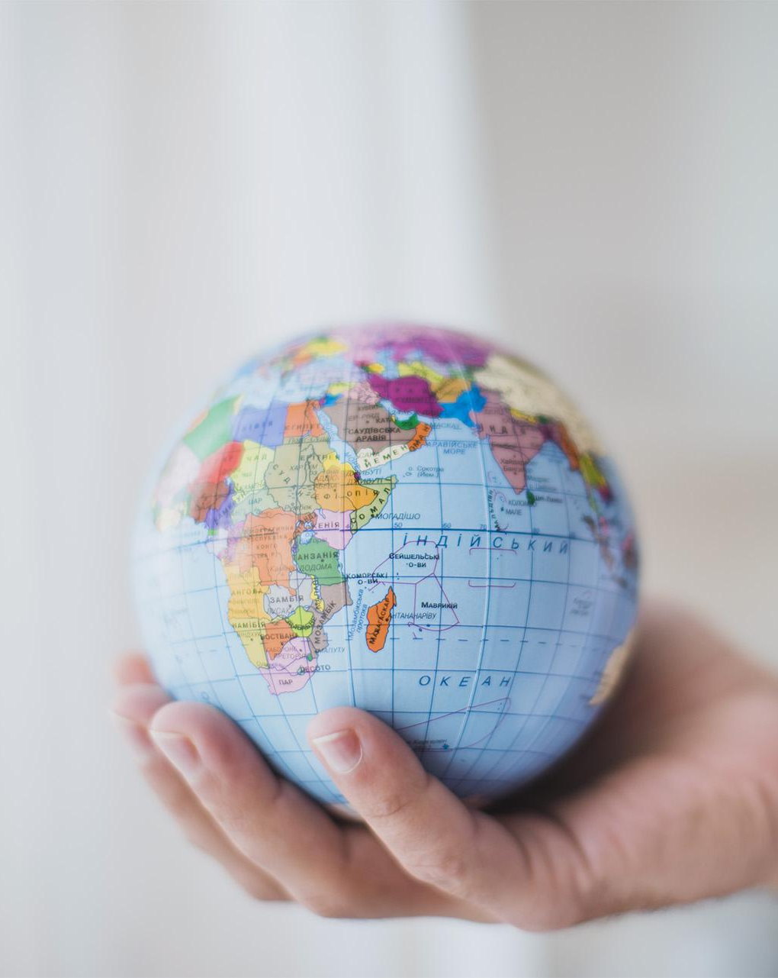
A PICTURE ALWAYS REINFORCES THE CONCEPT
Images reveal large amounts of data, so remember: use an image instead of long texts

Slide 14
A PICTURE IS WORTH A
THOUSAND WORDS

Slide 15
THIS IS A MAP
Venus has a beautiful
name
Mars is actually a cold place
Mercury is the smallest
planet

Slide 16
YOU COULD USE ONE COLUMN, WHY NOT?
Mars
Despite being red, Mars is actually a cold place. It’s full of iron oxide dust

Slide 17
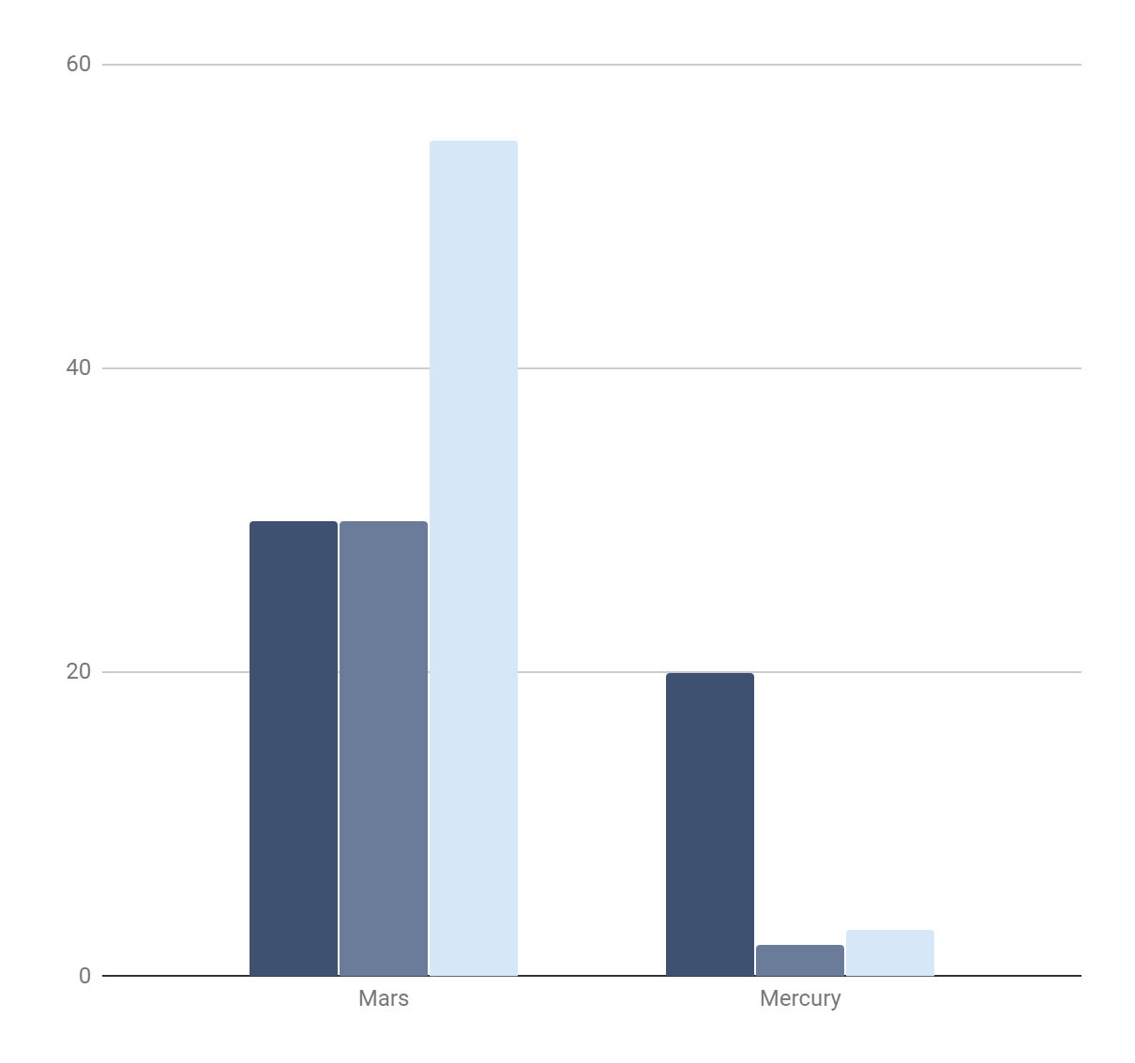
USE A GRAPH TO DISPLAY YOUR DATA
Venus
Mercury
Saturn
Mars
Despite being red, Mars is actually a cold place
Mercury
Mercury is the closest planet to the Sun
To modify this graph, click on it, follow the link, change the data and paste the new graph here

Slide 18
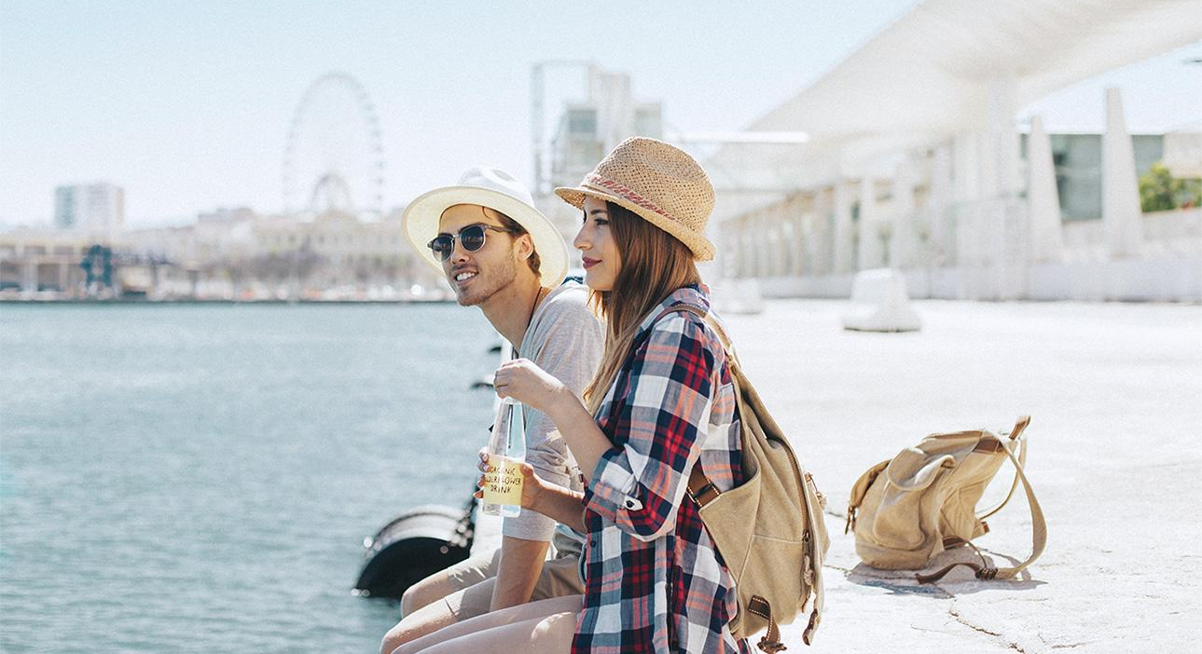
YOU COULD USE FOUR COLUMNS
Mars
Jupiter
Mercury
Neptune
Despite being red, Mars is actually a cold place
Jupiter is the biggest planet in the Solar System
Mercury is the smallest one in the Solar System
Neptune is the farthest planet from the Sun

Slide 19
SOMETIMES, REVIEWING CONCEPTS
IS A GOOD IDEA
Mars
Jupiter
Saturn
It’s a cold place full of iron oxide dust
It’s the biggest planet of them all
Yes, this is the ringed one. It’s a gas giant
Neptune
Venus
Mercury
It’s the farthest planet from the Sun
It’s the second planet from the Sun
It’s the smallest one in the Solar System

Slide 20
02 SECTION
You can enter a subtitle here if you need it

Slide 21
HOW ABOUT THE PERCENTAGES?
50%
Jupiter
60%
Saturn
80%
Mars
100%
Mercury

Slide 22
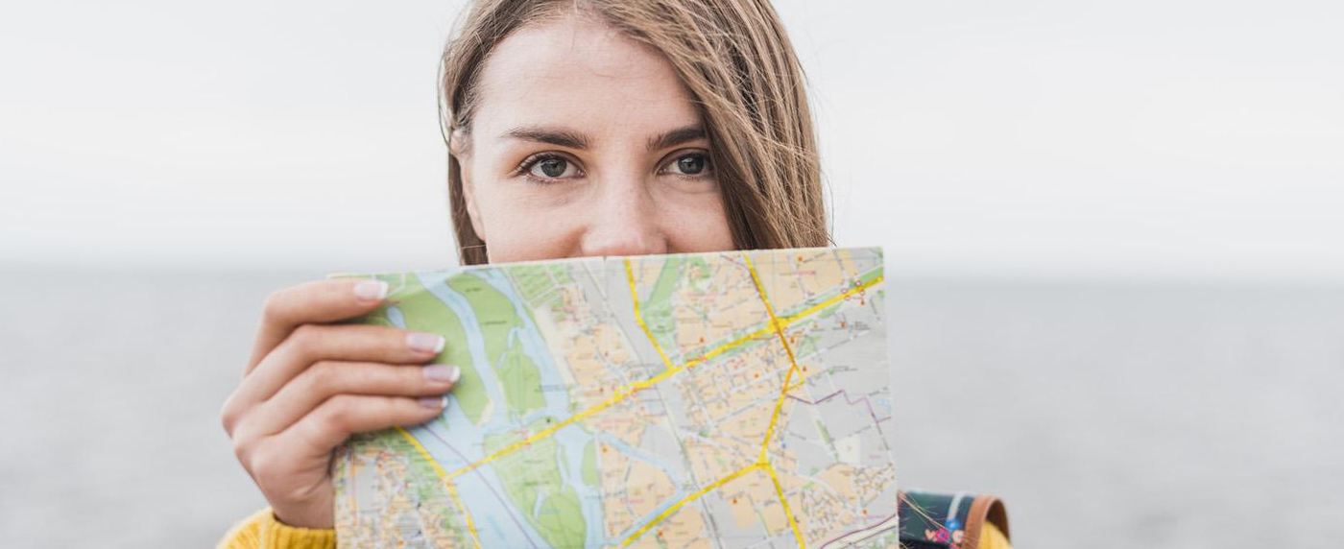
HOW ABOUT OTHER PERCENTAGES?
Mars
Saturn
60%
Neptune
Jupiter
30%

Slide 23
INFOGRAPHICS MAKE YOUR IDEA
UNDERSTANDABLE
Mars is actually a cold place
Venus has a beautiful
name
Jupiter is the biggest planet
Mercury is the smallest
planet

Slide 24
AND THE SAME GOES
FOR TABLES
 | Mars | Jupiter | Saturn
Mass | 0.06 | 0.11 | 95.2
Diameter | 0.38 | 0.53 | 9.4

Slide 25
A TIMELINE ALWAYS
WORKS WELL
1
2
3
4
Mercury
Mars
Jupiter
Neptune
Mercury is small
Mars is a cold place
Jupiter is the biggest
Neptune is the farthest

Slide 26
A TIMELINE ALWAYS
WORKS FINE
We live on Earth
Mars is a cold place
Neptune is the farthest
Venus is very hot
Jupiter is the biggest

Slide 27
03 DATES
You can enter a subtitle here if you need it

Slide 28
4,498,300,000
Big numbers catch your audience’s attention

Slide 29
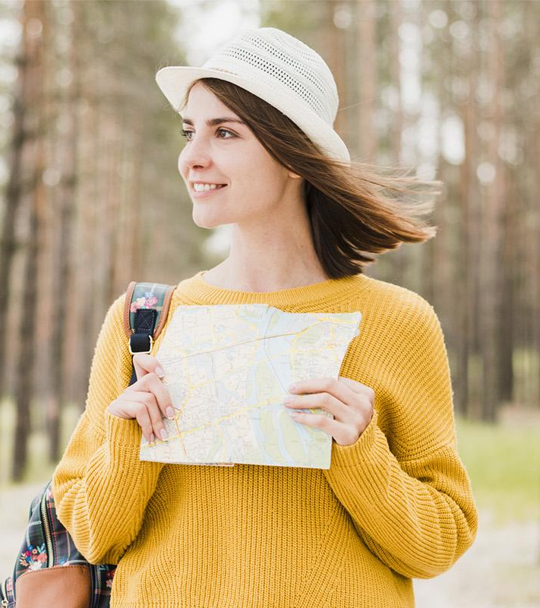
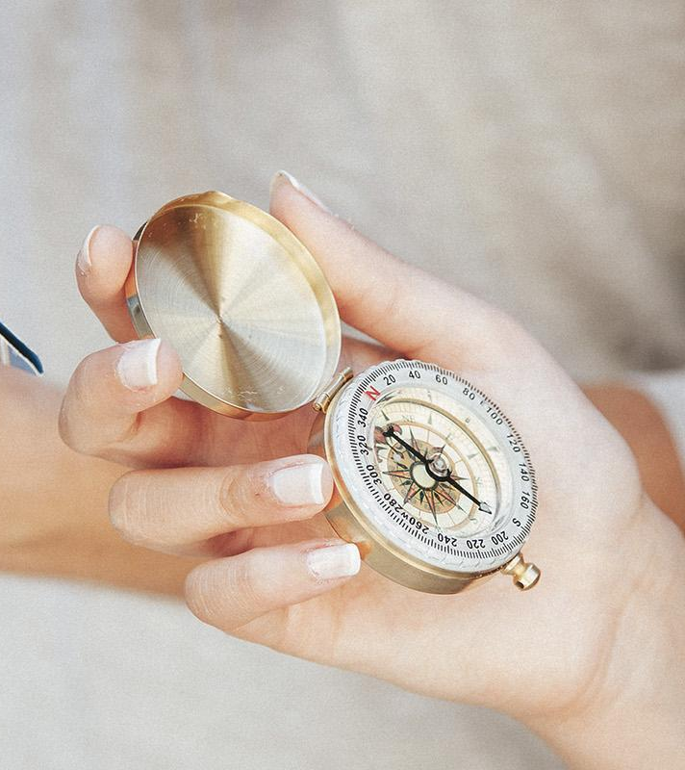
333,000.00
Earths is the Sun’s mass
24h 37m 23s
Is Jupiter’s rotation period
386,000 km
Distance from the Moon

Slide 30
04 ANALYSIS
You can enter a subtitle here if you need it

Slide 31
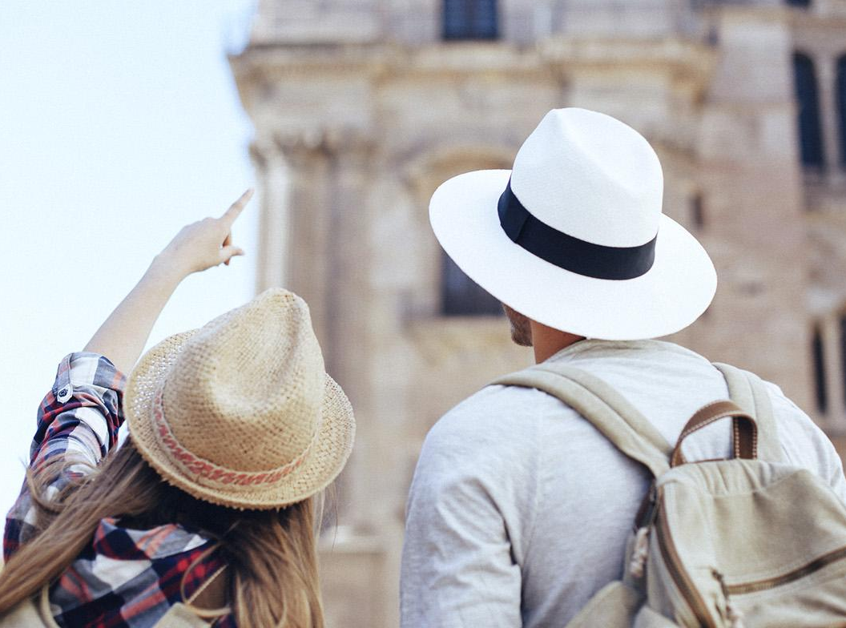
MULTIMEDIA CONTENT
Jupiter
Despite being red, Mars is actually a cold place. It’s full of iron oxide dust

Slide 32
OUR TEAM
John Doe
Helena James
You can replace the image on the screen with your own one
You can replace the image on the screen with your own one

Slide 33
OUR TEAM
John Doe
Helena James
Sarah Patterson
Despite being red, Mars is actually a cold place
Venus has a beautiful name, but it’s terribly hot
Neptune is the farthest planet from the Sun

Slide 34
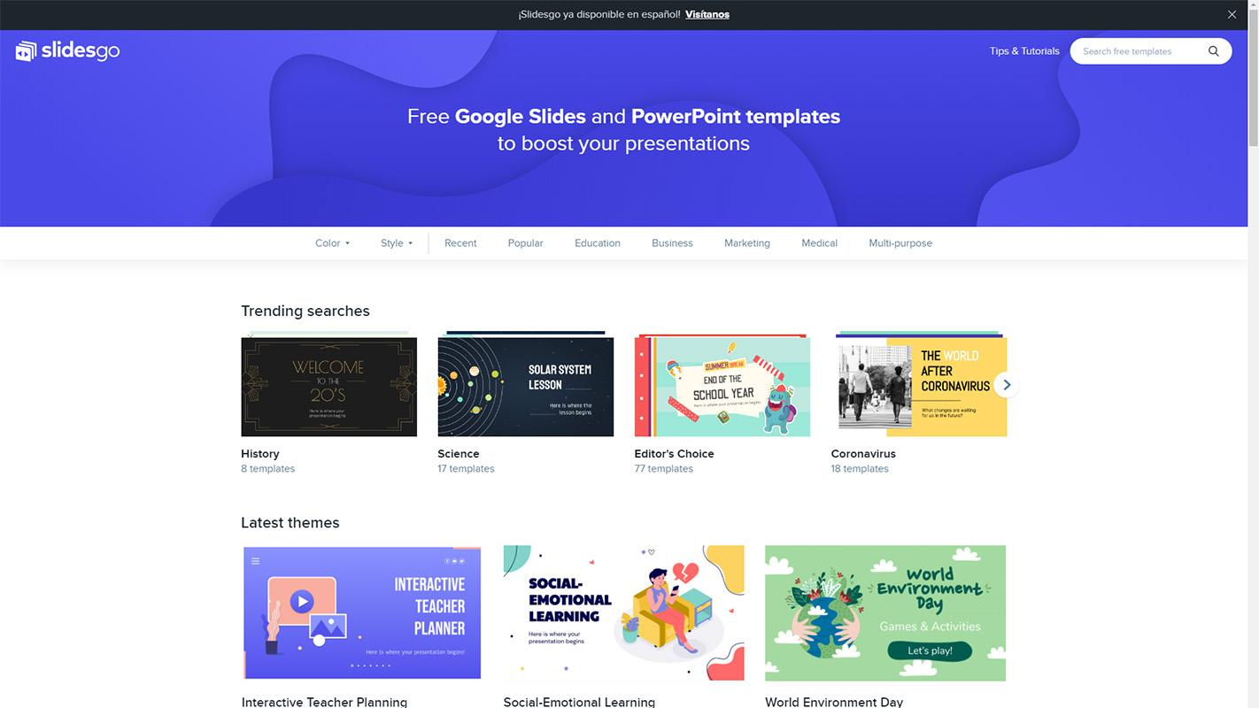
DESKTOP
SOFTWARE
Mars
You can replace the image on the screen with your own work. Just delete this one, add yours and center it properly

Slide 35
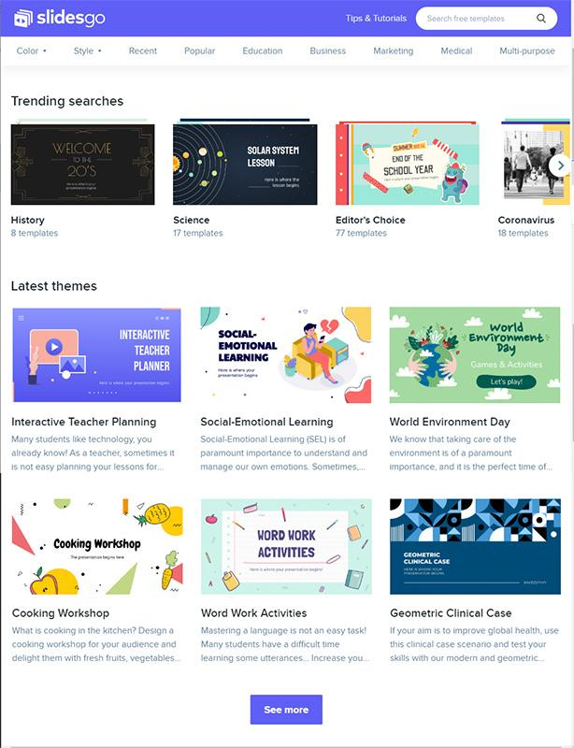
TABLET
APP
Venus
You can replace the image on the screen with your own work. Just delete this one, add yours and center it properly

Slide 36
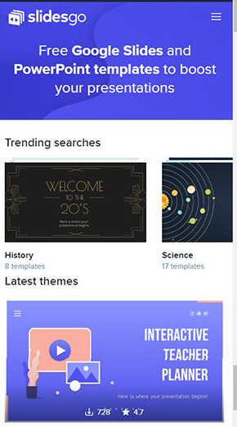
MOBILE
WEB
Jupiter
You can replace the image on the screen with your own work. Just delete this one, add yours and center it properly

Slide 37
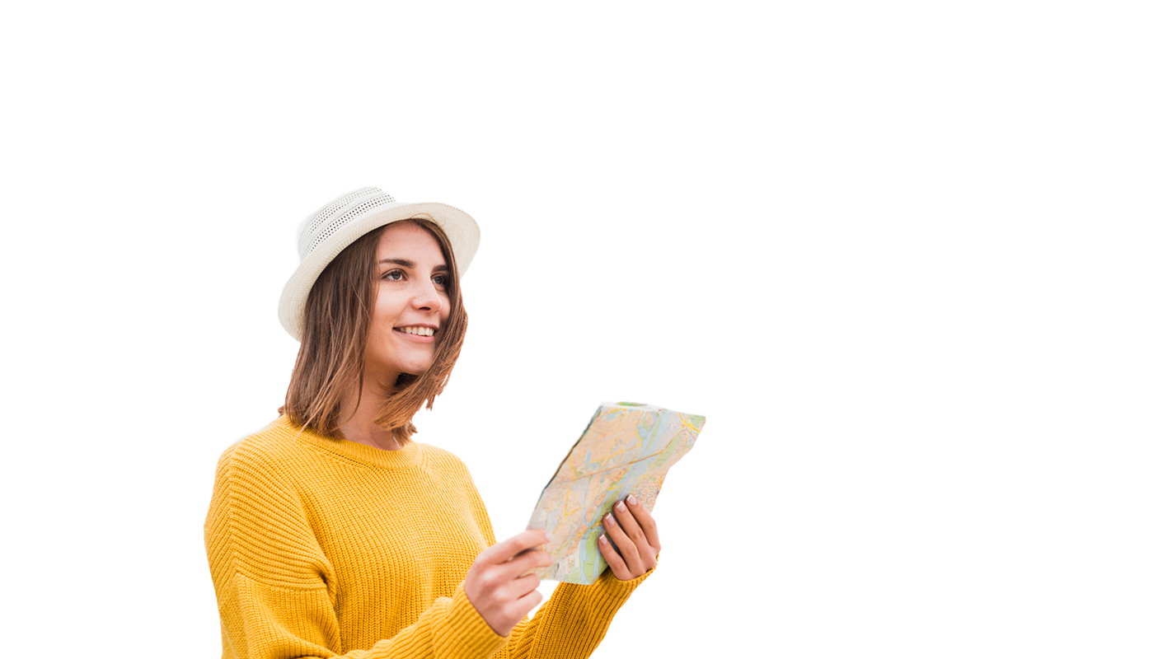
Thanks!
Do you have any questions?
addyouremail@freepik.com +91 620 421 838 yourcompany.com
PLEASE KEEP THIS SLIDE FOR ATTRIBUTION

Slide 38
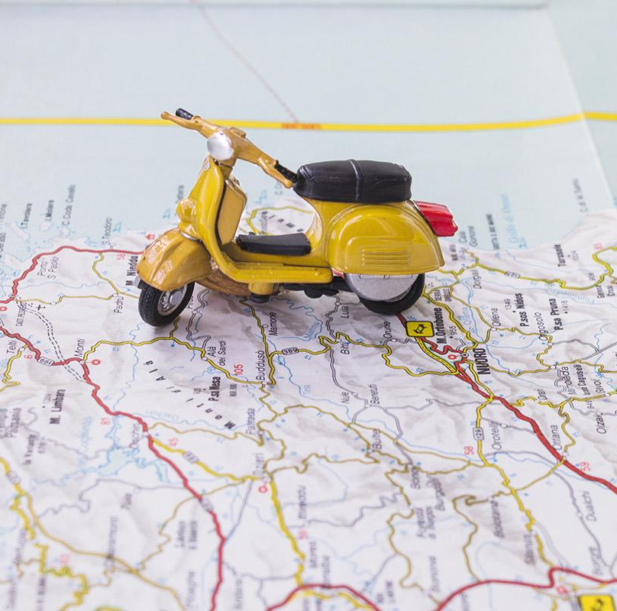
ALTERNATIVE RESOURCES
Photos
Traveling woman hitchhiking sitting
Traveler holding phone
Traveler taking selfie
Travelers searching map
Tourist woman pointing paper
Lovely traveler checking her phone
Paper plane globe
Hand protecting globe
Couple vacation city
Couple travelers pointing directions
Happy travelers-with map
Student using world globe
Solo-travelling-woman

Slide 39
RESOURCES
Photos
Landscape lake surrounded
Field sunflowers plants
Farm field landscape
Modern road surrounded
Beautiful single sun
Smiley-travelling-woman-taking-selfie
Peaceful tropical rainforest
Woman checking map
High-angle-view-mountain
Toy motorcycle map
Traveling woman road
Traveler beach
Traveling-woman-holding-map
Travelers hand with compass
Traveler using smartphone
Traveler taking a photo
Traveling woman taking her backpack out
Traveler looking away
Traveler facing sea
Tourist city

Slide 40
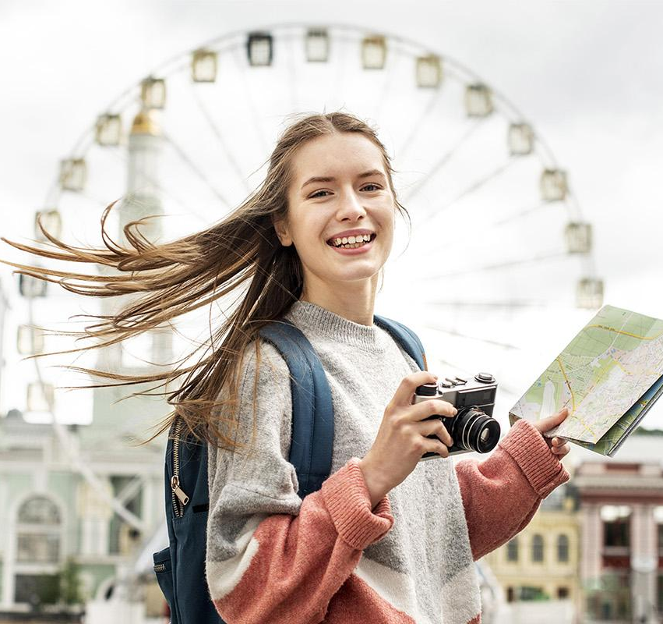
RESOURCES
Photos
Traveling woman holding map facing camera
Camel desert land
Couple tourists coast
Couple visiting city
Close up hand holding small globe
Young tourists discovering city
Young man working
Vectors
Responsive web design electronic devices
Youtube player with flat design

Slide 41
Instructions for use
In order to use this template, you must credit Slidesgo by keeping the Thanks slide.
You are allowed to:
- Modify this template.
- Use it for both personal and commercial projects.
You are not allowed to:
- Sublicense, sell or rent any of Slidesgo Content (or a modified version of Slidesgo Content).
- Distribute Slidesgo Content unless it has been expressly authorized by Slidesgo.
- Include Slidesgo Content in an online or offline database or file.
- Offer Slidesgo templates (or modified versions of Slidesgo templates) for download.
- Acquire the copyright of Slidesgo Content.
For more information about editing slides, please read our FAQs or visit Slidesgo School:
https://slidesgo.com/faqs and https://slidesgo.com/slidesgo-school

Slide 42
Fonts & colors used
This presentation has been made using the following fonts:
Montserrat
(https://fonts.google.com/specimen/Montserrat)
#ef7d4b
#3f5170
#7bc3aa
#d6e7f8

Slide 43
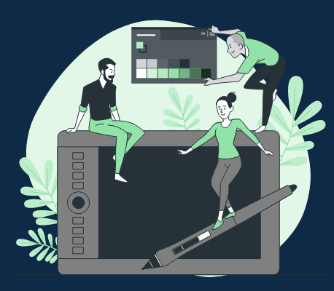
Stories by Freepik
Create your Story with our illustrated concepts. Choose the style you like the most, edit its colors, pick the background and layers you want to show and bring them to life with the animator panel! It will boost your presentation. Check out How it Works.
Pana
Amico
Bro
Rafiki

Slide 44
Use our editable graphic resources...
You can easily resize these resources without losing quality. To change the color, just ungroup the resource and click on the object you want to change. Then, click on the paint bucket and select the color you want. Group the resource again when you’re done. You can also look for more infographics on Slidesgo.

Slide 47
JANUARY
FEBRUARY
MARCH
APRIL
MAY
JUNE
PHASE 1
Task 1
Task 2
PHASE 2
Task 1
Task 2
JANUARY
FEBRUARY
MARCH
APRIL
PHASE 1
Task 1
Task 2

Slide 50
...and our sets of editable icons
You can resize these icons without losing quality.
You can change the stroke and fill color; just select the icon and click on the paint bucket/pen.
In Google Slides, you can also use Flaticon’s extension, allowing you to customize and add even more icons.

Slide 51
Educational Icons
Medical Icons

Slide 52
Business Icons
Teamwork Icons

Slide 53
Help & Support Icons
Avatar Icons

Slide 54
Creative Process Icons
Performing Arts Icons

Slide 55
Nature Icons

Slide 56
SEO & Marketing Icons

